Slide 1

ALS Detection from EHR
Moshiko Cohen
Gilad Erez

Slide 2
Topic & Motivation
ALS - neurodegenerative disease
Heterogenous – has many progression profiles
No sufficient risk factors are known
Diagnosis is done based on symptoms
The disease is incurable
Motivation
EHR
Data Understanding
Data Preparation
Trimming Test
Conclusions
Future Ideas

Slide 3



Topic & Motivation
Early detection of ALS disease with EHR
Earlier Hence Better Treatment
Improving Quality of Life
Shorter Period of Diagnosis
Motivation
EHR
Data Understanding
Data Preparation
Trimming Test
Conclusions
Future Ideas

Slide 4
Electronic Health Records
The EHR is a digital collection of medical information, including:
Demographics
Personal statistics
Lab-Tests results
Diagnosis
Prescriptions
Visits
Etc.
Visit
Lab-Test
Visit
Diagnosis
Prescription
Motivation
EHR
Data Understanding
Data Preparation
Trimming Test
Conclusions
Future Ideas

Slide 5

Electronic Health Records
162 Patients
648 Controls
Controls are matched with Patients by physical similarities
Data is imbalanced
Over up to 16 years prior to the diagnosis
Motivation
EHR
Data Understanding
Data Preparation
Trimming Test
Conclusions
Future Ideas

Slide 6
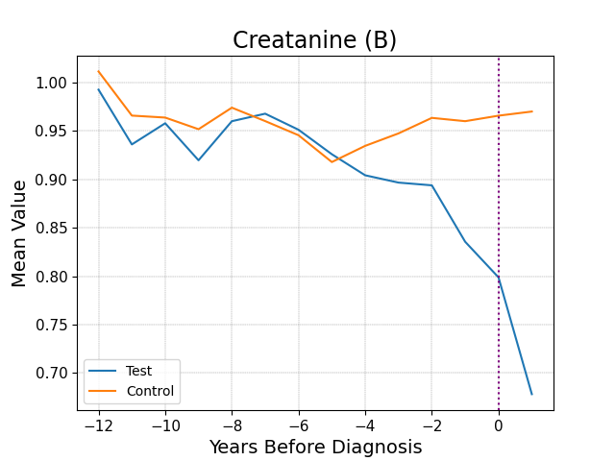
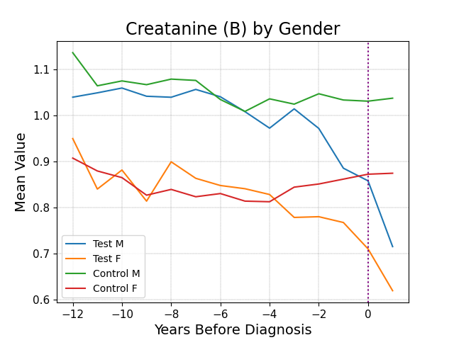
Data Understanding
Motivation
EHR
Data Understanding
Data Preparation
Trimming Test
Conclusions
Future Ideas

Slide 7
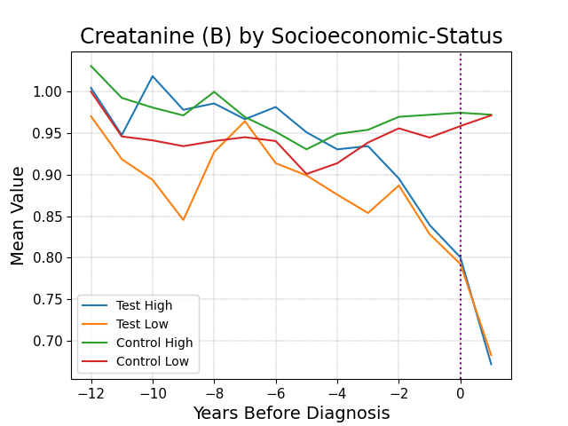
Data Understanding
Motivation
EHR
Data Understanding
Data Preparation
Trimming Test
Conclusions
Future Ideas

Slide 8
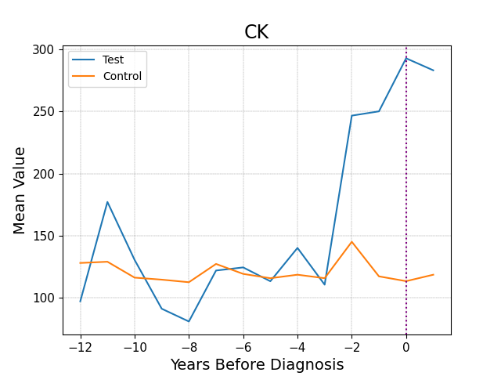
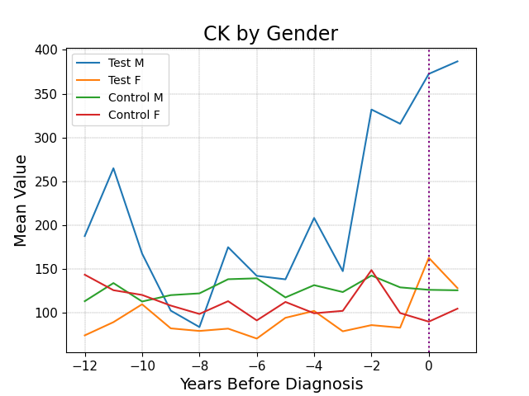
Data Understanding
Motivation
EHR
Data Understanding
Data Preparation
Trimming Test
Conclusions
Future Ideas

Slide 9
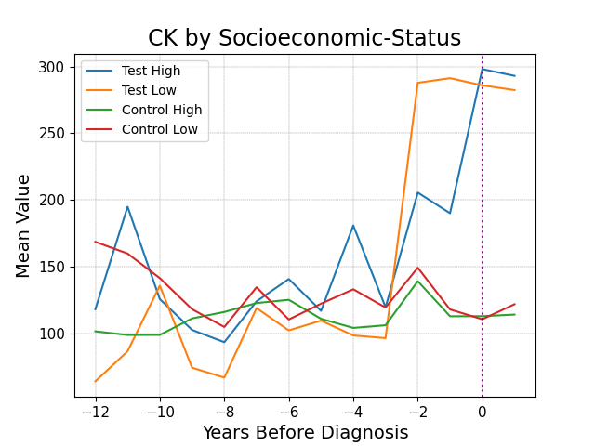
Data Understanding
Motivation
EHR
Data Understanding
Data Preparation
Trimming Test
Conclusions
Future Ideas

Slide 10
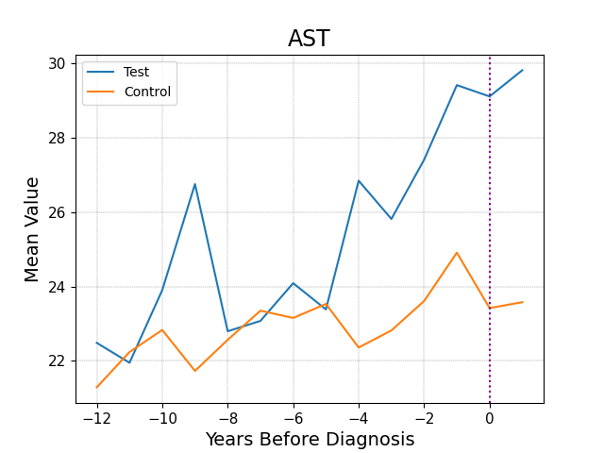
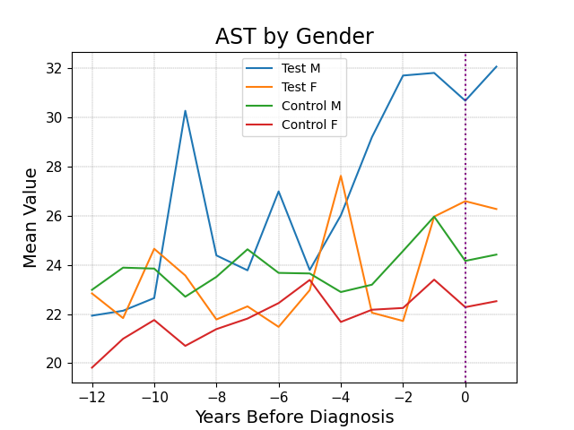
Data Understanding
Motivation
EHR
Data Understanding
Data Preparation
Trimming Test
Conclusions
Future Ideas

Slide 11
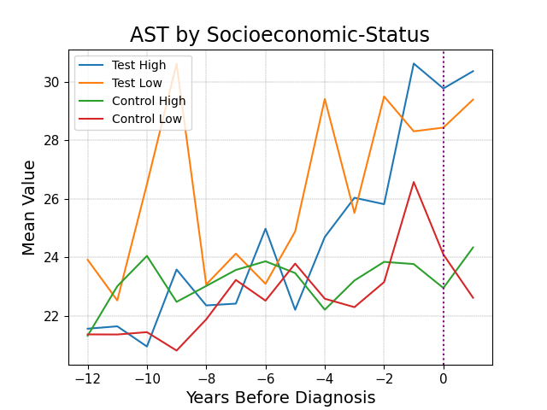
Data Understanding
Motivation
EHR
Data Understanding
Data Preparation
Trimming Test
Conclusions
Future Ideas

Slide 12
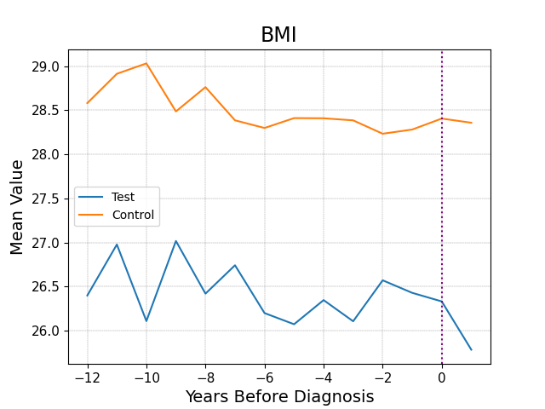
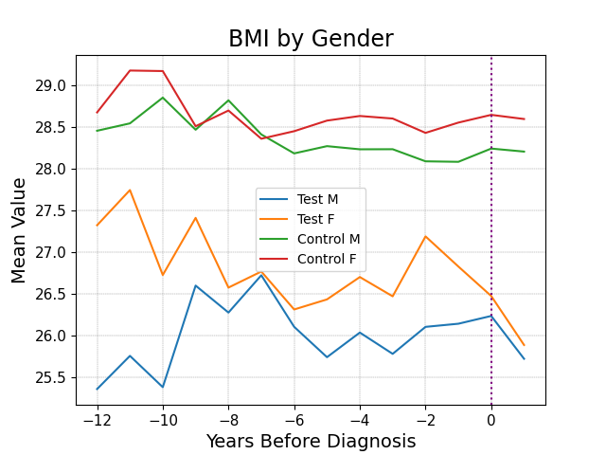
Data Understanding
Motivation
EHR
Data Understanding
Data Preparation
Trimming Test
Conclusions
Future Ideas

Slide 13
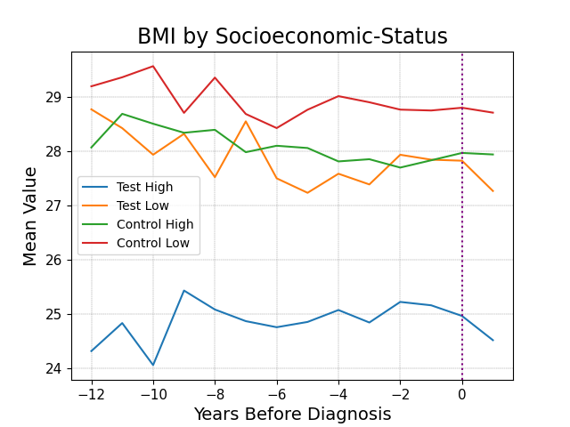
Data Understanding
Motivation
EHR
Data Understanding
Data Preparation
Trimming Test
Conclusions
Future Ideas

Slide 14
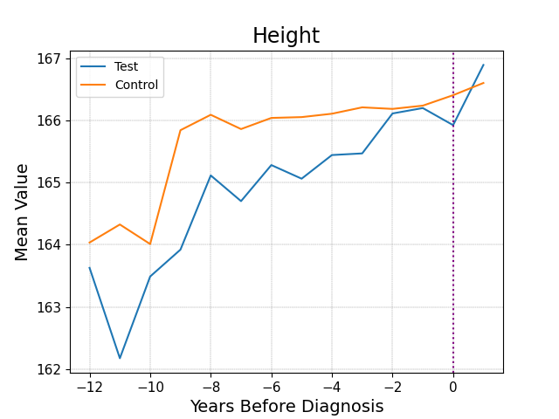
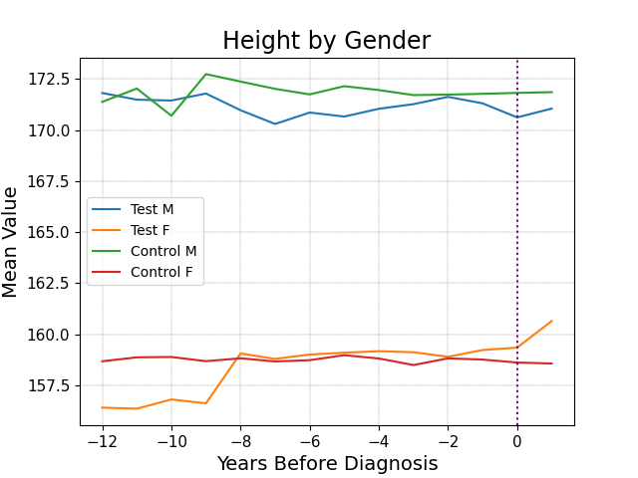
Data Understanding
Motivation
EHR
Data Understanding
Data Preparation
Trimming Test
Conclusions
Future Ideas

Slide 15
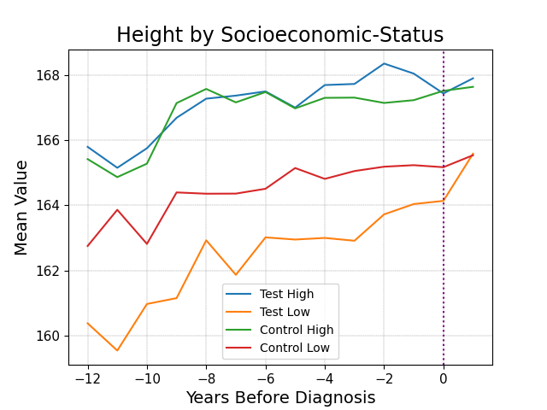
Data Understanding
Motivation
EHR
Data Understanding
Data Preparation
Trimming Test
Conclusions
Future Ideas

Slide 16
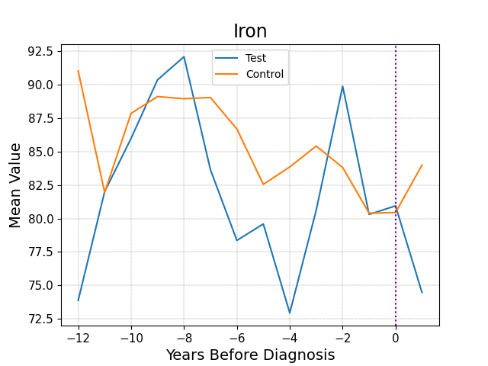
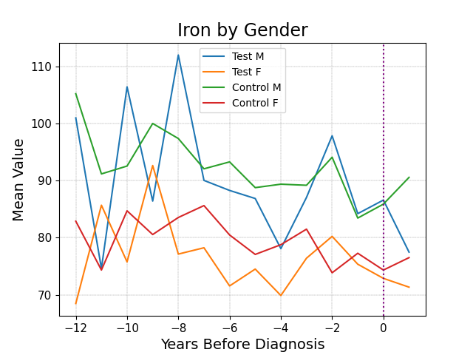
Data Understanding
Motivation
EHR
Data Understanding
Data Preparation
Trimming Test
Conclusions
Future Ideas

Slide 17
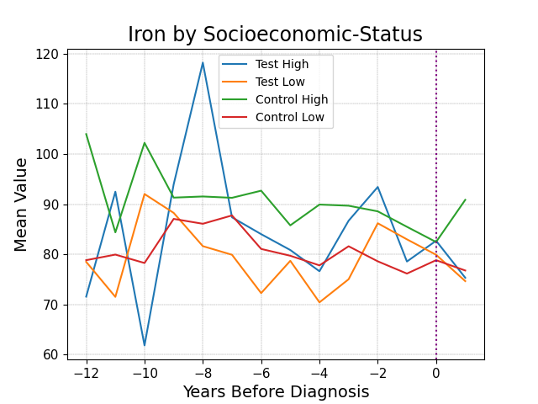
Data Understanding
Motivation
EHR
Data Understanding
Data Preparation
Trimming Test
Conclusions
Future Ideas

Slide 18
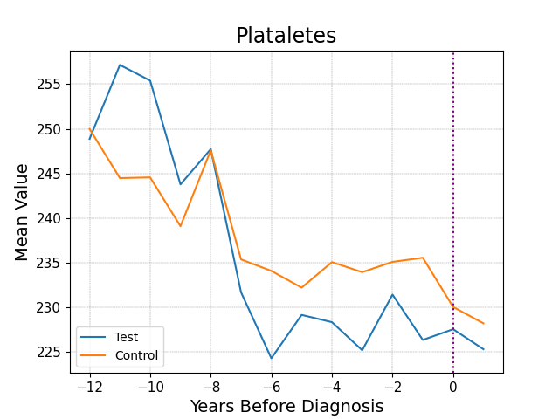
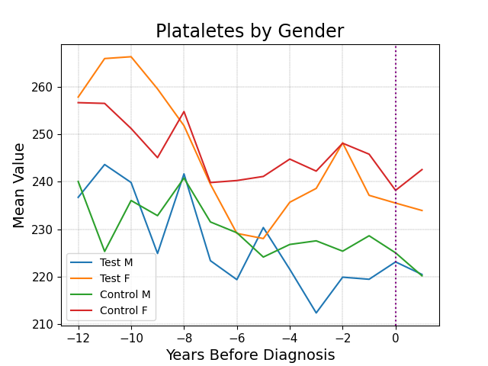
Data Understanding
Motivation
EHR
Data Understanding
Data Preparation
Trimming Test
Conclusions
Future Ideas

Slide 19
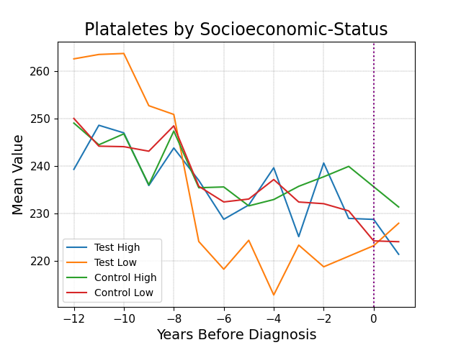
Data Understanding
Motivation
EHR
Data Understanding
Data Preparation
Trimming Test
Conclusions
Future Ideas

Slide 20
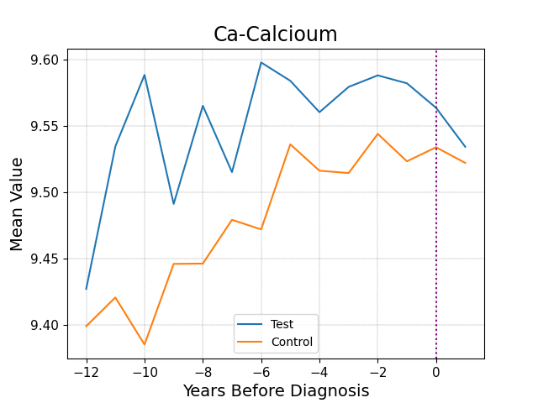
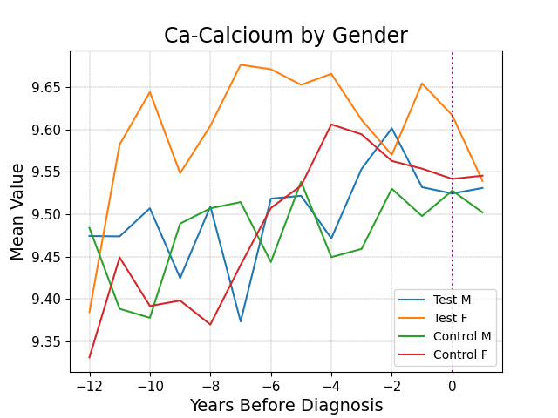
Data Understanding
Motivation
EHR
Data Understanding
Data Preparation
Trimming Test
Conclusions
Future Ideas

Slide 21
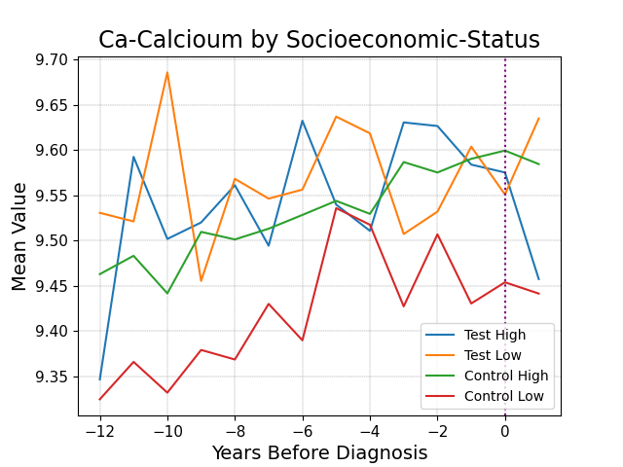
Data Understanding
Motivation
EHR
Data Understanding
Data Preparation
Trimming Test
Conclusions
Future Ideas

Slide 22
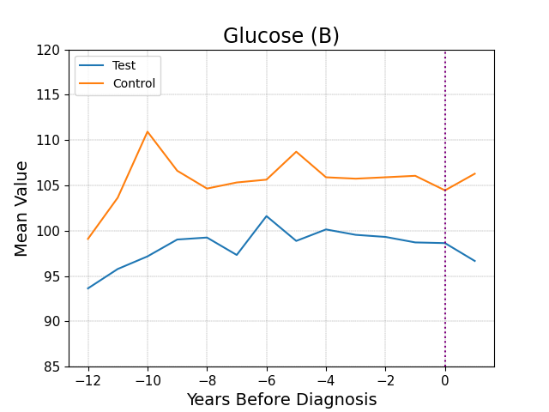
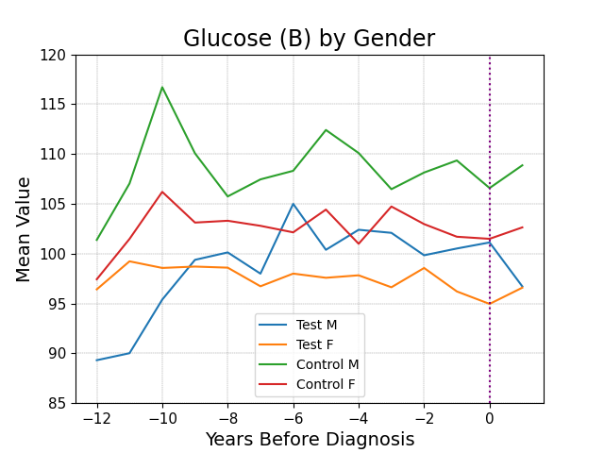
Data Understanding
Motivation
EHR
Data Understanding
Data Preparation
Trimming Test
Conclusions
Future Ideas

Slide 23
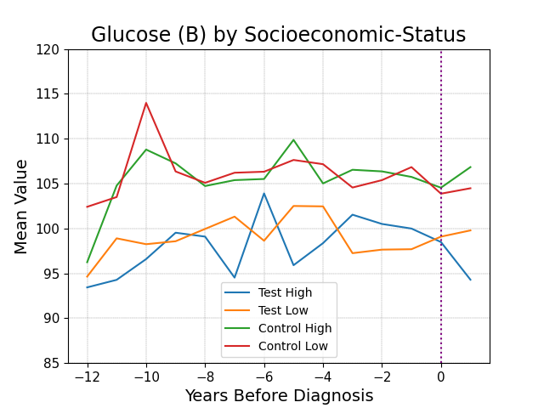
Data Understanding
Motivation
EHR
Data Understanding
Data Preparation
Trimming Test
Conclusions
Future Ideas

Slide 24
Data Preparation
Diagnosis
Lab-Tests
Prescriptions
Date | Diagnosis | ID
1/1/2000 | ALS | 4
7/5/2013 | IBD | 513
4/1/2004 | Covid-19 | 66
 | …
1/9/1995 | Influenza | 67,083
Result | Test # | ID
0.5 | 4045 | 4
112 | 2445 | 513
7 | 50022 | 66
 | …
24 | 3037 | 67,083
Date | Drug | ID
2/3/2020 | N02 | 4
3/7/2011 | J01 | 513
4/6/2001 | D07 | 66
 | …
8/8/1998 | M01 | 67,083
Motivation
EHR
Data Understanding
Data Preparation
Trimming Test
Conclusions
Future Ideas

Slide 25
Data Preparation
134
Date | ID
1/1/22 | 564
1/3/20 | 325
5/6/19 | 64
8/7/11 | 372
5/5/16 | 648
9/1/21 | 8654
6/6/13 | 452
Diag. 50 | … | Diag. 1
- | - | 1
- | - | -
1 | - | -
- | - | -
- | - | -
- | - | -
- | - | -
Test 30 | … | Test 1
- | - | -
- | - | 0.2
- | - | -
1.1 | - | -
- | - | -
- | - | -
- | - | -
Drug 50 | … | Drug 1
- | - | -
- | - | -
- | - | -
- | - | -
1 | - | -
- | - | 1
1 | - | -
Age | Gender
56 | 0
25 | 1
4 | 1
73 | 0
105 | 0
23 | 0
44 | 1
137,000
Merged table is extremely sparse
Number of rows is enormous
Motivation
EHR
Data Understanding
Data Preparation
Trimming Test
Conclusions
Future Ideas

Slide 26
Data Preparation
Date | ID
1/1/22 | 564
1/3/20 | 564
5/6/19 | 564
8/7/11 | 564
Diag. 50 | … | Diag. 1
- | - | 1
- | - | -
1 | - | -
- | - | -
Test 30 | … | Test 1
- | - | -
- | - | 0.2
- | - | -
1.1 | - | -
Drug 50 | … | Drug 1
- | - | -
- | - | -
- | - | -
- | - | -
Age | Gender
62 | 0
60 | 0
59 | 0
51 | 0
aggregate
Moment Extraction
Average
Std.
Error
Max
Min
Reg.
Slope
Reg.
Intercept
Motivation
EHR
Data Understanding
Data Preparation
Trimming Test
Conclusions
Future Ideas

Slide 27


Data Preparation
Average
$$value$$
Std.
Max
Min
Slope
Intercept
$$time$$
0
Motivation
EHR
Data Understanding
Data Preparation
Trimming Test
Conclusions
Future Ideas

Slide 28
Data Preparation
Moment Extraction
Date | ID
1/1/22 | 564
1/3/20 | 564
5/6/19 | 564
8/7/11 | 564
Diag. 50 | … | Diag. 1
- | - | 1
- | - | -
1 | - | -
- | - | -
Test 30 | … | Test 1
- | - | -
- | - | 0.2
- | - | -
1.1 | - | -
Drug 50 | … | Drug 1
- | - | -
- | - | -
- | - | -
- | - | -
Gender
0
0
0
0
aggregate
ID
564
… | Test 2 Std. | … | Test 2 Average | Test 1 Std. | … | Test 1 Average
… | nan | … | 40 | 29 | … | 50
Test 30 Std. | … | Test 30 Average
nan | … | 40
Gender
0
Number of Features is enormous
Moments require DF’s – missing values appear
Motivation
EHR
Data Understanding
Data Preparation
Trimming Test
Conclusions
Future Ideas

Slide 29
Data Preparation
ID
564
… | Test 2 M6 | … | Test 2 M1 | Test 1 M6 | … | Test 1 M1
… | nan | … | 40 | 29 | … | 50
Test 30 M6 | … | Test 30 M1
nan | … | 40
Gender
0
Control ID | Group | Socio. Status
564 | 1 | 7
243 | 0 | 3
Values Imputation
ID
564
… | Test 2 M6 | … | Test 2 M1 | Test 1 M6 | … | Test 1 M1
… | 44 | … | 40 | 29 | … | 50
Test 30 M6 | … | Test 30 M1
35 | … | 40
Gender
0
Control ID | Group | Socio. Status
564 | 1 | 7
243 | 0 | 3
Imputation was made with “Iterative-Imputer”,
A regression based imputer
Motivation
EHR
Data Understanding
Data Preparation
Trimming Test
Conclusions
Future Ideas

Slide 30

Data Preparation
ID
564
… | Test 2 M6 | … | Test 2 M1 | Test 1 M6 | … | Test 1 M1
… | nan | … | 40 | 29 | … | 50
Test 30 M6 | … | Test 30 M1
nan | … | 40
Gender
0
Control ID | Group | Socio. Status
564 | 1 | 7
243 | 0 | 3
mean
$$\hat{Y}$$
A feature is randomly selected
All other nan.s are assigned naively
A regression model is trained as X = (all features) , y = (chosen feature)
Chosen feature’s nan.s are predicted
Naïve assignments are deleted
Next feature is selected
Motivation
EHR
Data Understanding
Data Preparation
Trimming Test
Conclusions
Future Ideas

Slide 31
Data Preparation
ID
564
… | Test 2 M6 | … | Test 2 M1 | Test 1 M6 | … | Test 1 M1
… | 44 | … | 40 | 29 | … | 50
Test 30 M6 | … | Test 30 M1
35 | … | 40
Gender
0
Control ID | Group | Socio. Status
564 | 1 | 7
243 | 0 | 3
Random Forest
Forest
Feature Importance
Motivation
EHR
Data Understanding
Data Preparation
Trimming Test
Conclusions
Future Ideas

Slide 32
Trimming Test
-10
0
Motivation
EHR
Data Understanding
Data Preparation
Trimming Test
Conclusions
Future Ideas

Slide 33

Trimming Test
-10
0
Matched
train-test division
Feature selection by importance
10 years
Trimming loop
(Jump = 6)
Moment
extraction
Cleaning sparse
features & patients
Imputation
Forest Validation & training
Motivation
EHR
Data Understanding
Data Preparation
Trimming Test
Conclusions
Future Ideas

Slide 34
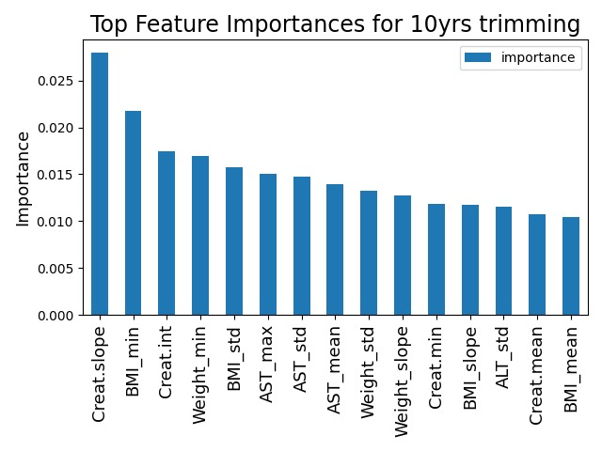
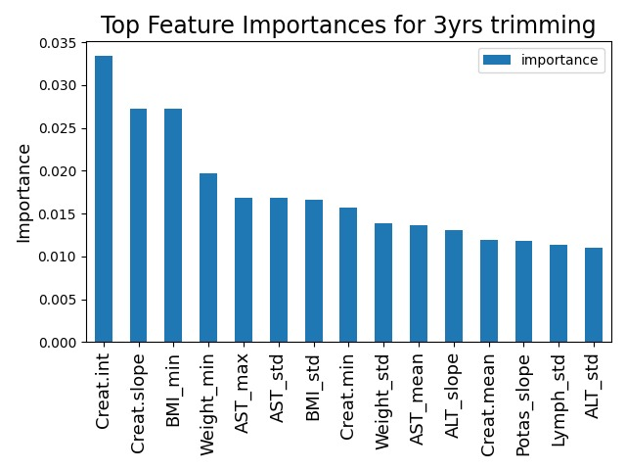
Why Check Importance for Each Trimming?
Motivation
EHR
Data Understanding
Data Preparation
Trimming Test
Conclusions
Future Ideas

Slide 35
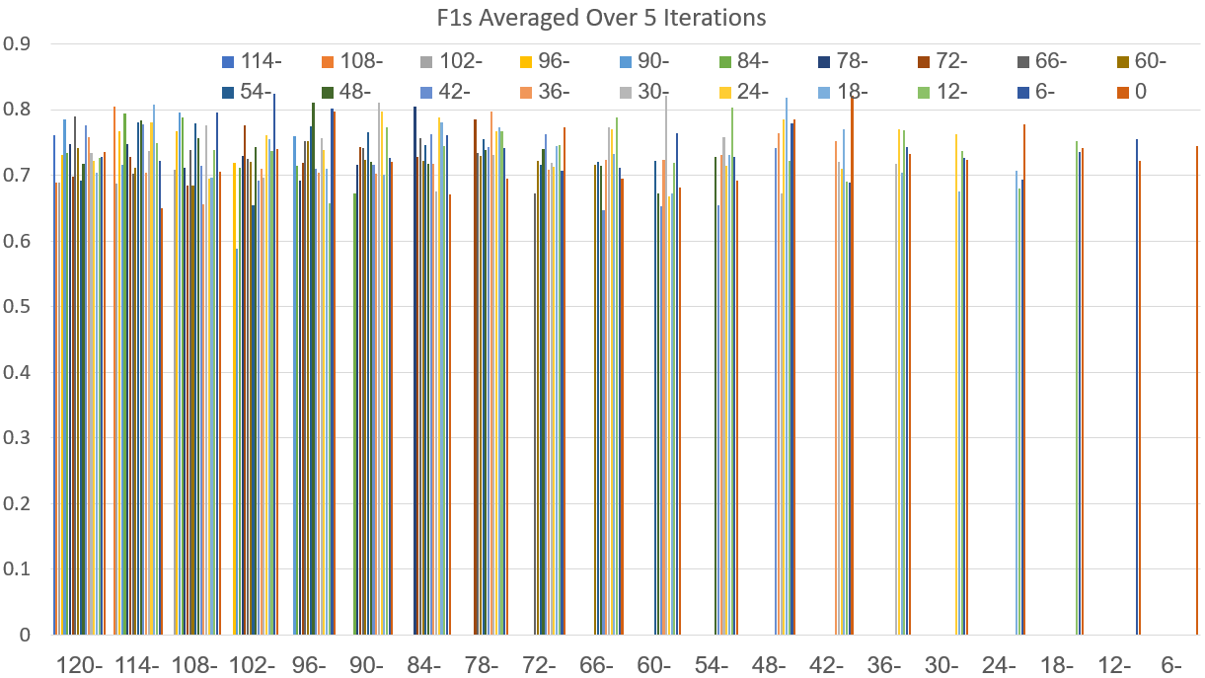
Trimming Test
End time:
f1
Start time

Slide 36
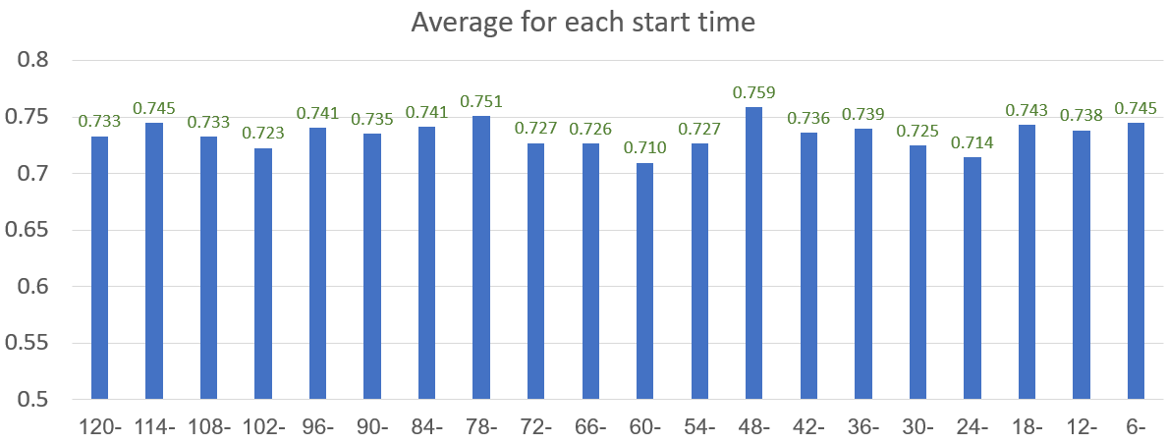
Trimming Test
f1
Start time
Motivation
EHR
Data Understanding
Data Preparation
Trimming Test
Conclusions
Future Ideas

Slide 37
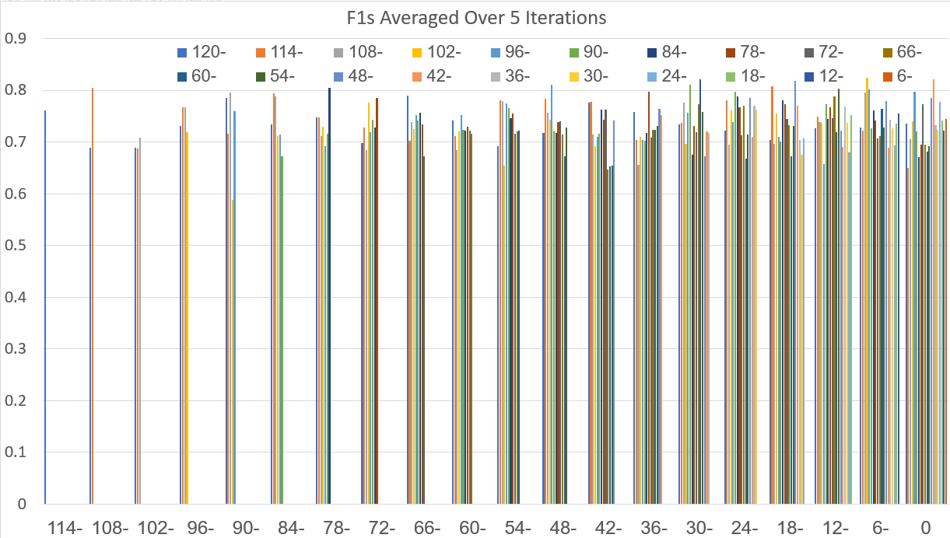
Trimming Test
End time:
f1
End time

Slide 38
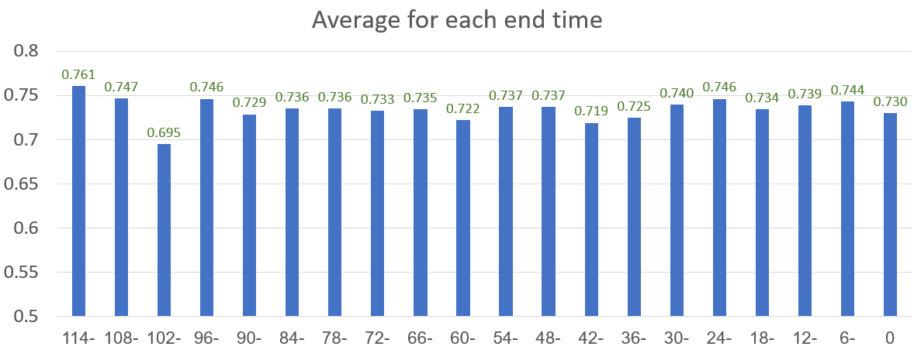
Trimming Test
f1
End time
Motivation
EHR
Data Understanding
Data Preparation
Trimming Test
Conclusions
Future Ideas

Slide 39
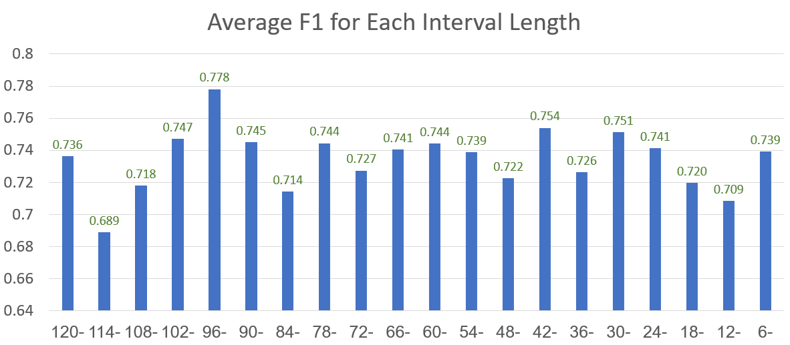
Trimming Test
Less Imputation Less Division
More Imputation More Division
Motivation
EHR
Data Understanding
Data Preparation
Trimming Test
Conclusions
Future Ideas

Slide 40
Trimming Test
Slope Test = 5
Slope Control = -1
Slope Test = 2
Slope Control = 0
Less Imputation Less Division
More Imputation More Division
Motivation
EHR
Data Understanding
Data Preparation
Trimming Test
Conclusions
Future Ideas

Slide 41
Conclusions
No trimming strategy is significantly preferred
Data preparation is as important as model’s quality
Lab-Tests are a good input for classification models
Motivation
EHR
Data Understanding
Data Preparation
Trimming Test
Conclusions
Future Ideas

Slide 42
Future Ideas
Moment extraction for multiple time sections
Fine tuning of imputation methods
Testing the abilities of temporal models
Motivation
EHR
Data Understanding
Data Preparation
Trimming Test
Conclusions
Future Ideas

Slide 43
Thank you for listening ☺

